Slide 1
Topic 14 The Tds Relations
Thermodynamics: An Engineering Approach
8th Edition Yunus A. Çengel, Michael A. Boles
McGraw-Hill, 2015

Slide 2
Objectives
Calculate the entropy changes that take place during processes for pure substances, incompressible substances, and ideal gases.
Examine a special class of idealized processes, called isentropic processes, and develop the property relations for these processes.

Slide 3


The T ds Relations
Recall the energy balance:
Now let’s apply this for an internally reversible process and let’s look at the differential form of the equation:
Previously we established that:
And recall that boundary work is:

Slide 4
The T ds Relations
Now substitute those two equations back into the energy balance equation yields
Recall what enthalpy is:
This can then be substituted into the Tds equation we just derived.

Slide 5
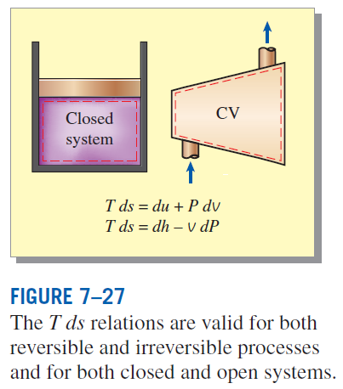


The T ds Relations
The first Tds relation: (Gibbs Equation)
The second Tds relation:
We can solve for ds in both equations:

Slide 6

ENTROPY CHANGE OF LIQUIDS AND SOLIDS
Recall liquids and solids are incompressible substances.
Liquids and solids can be approximated as incompressible substances since their specific volumes remain nearly constant during a process.
Recall specific heat equations:
For liquids and solids c_{p} = c_{v} = c

Slide 7



Entropy Changes of Liquids and Solids
Let’s assume that the specific heat is constant and represents an average value of the temperature range we are looking at:
What if the process is isentropic?
For solids and liquids, an isentropic process is also isothermal.

Slide 8
Effect of Density of a Liquid on Entropy
Solution
Liquid methane is commonly used in various cryogenic applications. The critical temperature of methane is 191 K and must be maintained below this temperature to remain in the liquid phase. Methane enters a pump at 110 K and 1 MPa and leaves at 120 K and 5 MPa. Determine the entropy change during this process by (a) using the table below and (b) using the Tds relations.
Properties of Liquid Methane
Temp | Pressure | Density | Enthalpy | Entropy | Specific Heat
T, K | P, MPa | ρ, kg/m³ | h, kJ/kg | s, kJ/kg K | c_{p}, kJ/kg K
110 | 0.5 | 425.3 | 208.3 | 4.878 | 3.476
 | 1 | 425.8 | 209.0 | 4.875 | 3.471
 | 2 | 426.6 | 210.5 | 4.867 | 3.460
 | 5 | 429.1 | 215.0 | 4.844 | 3.432
120 | 0.5 | 410.4 | 243.4 | 5.185 | 3.551
 | 1 | 411.0 | 244.1 | 5.180 | 3.543
 | 2 | 412.0 | 245.4 | 5.171 | 3.528
 | 5 | 415.2 | 249.6 | 5.145 | 3.486

Slide 9
Economics of Replacing a Valve by a Turbine
Solution
A cryogenic manufacturer handles liquid methane at 115 K and 5 MPa at a rate of 0.280 m³/s. The process involves dropping the pressure to 1 MPa by means of a throttling valve. An engineer proposes to replace the throttling valve with a turbine so power can be produced from the pressure drop. What is the maximum amount of power that can be produced by the turbine? Given that the turbine operates 8760 h/yr and the cost of electricity is $0.075/kWh, what is the maximum savings for the company if they use the turbine?

Slide 10



THE ENTROPY CHANGE OF IDEAL GASES
Recall Ideal Gas Equation:

Slide 11




THE ENTROPY CHANGE OF IDEAL GASES
Recall Ideal Gas Equation:

Slide 12
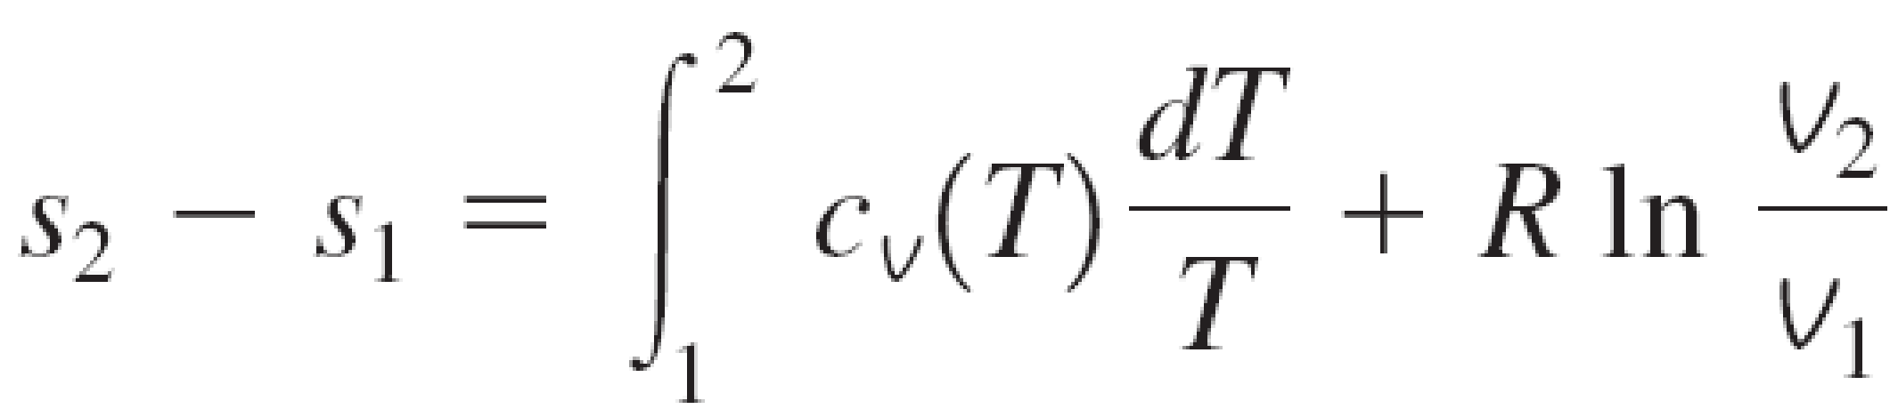
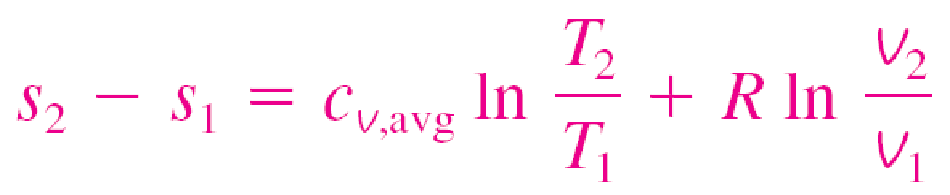
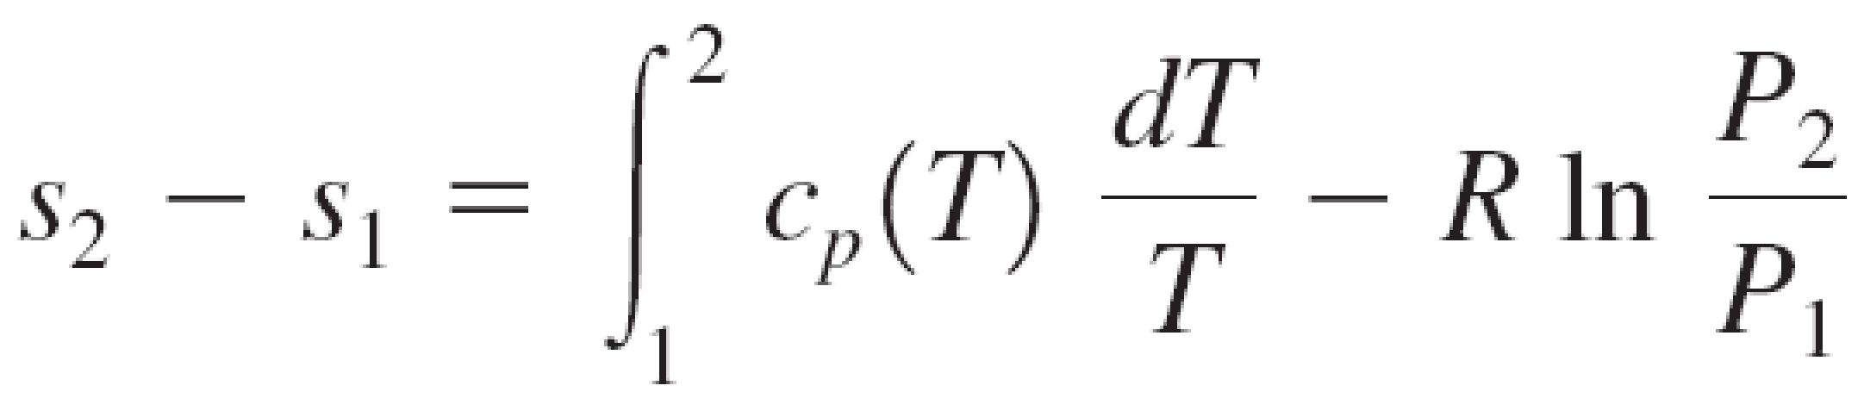
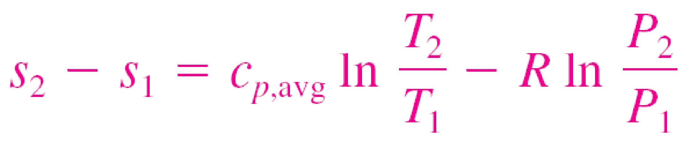

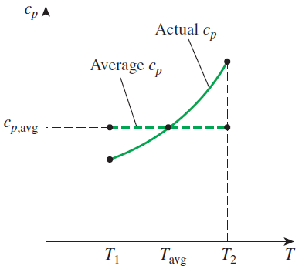
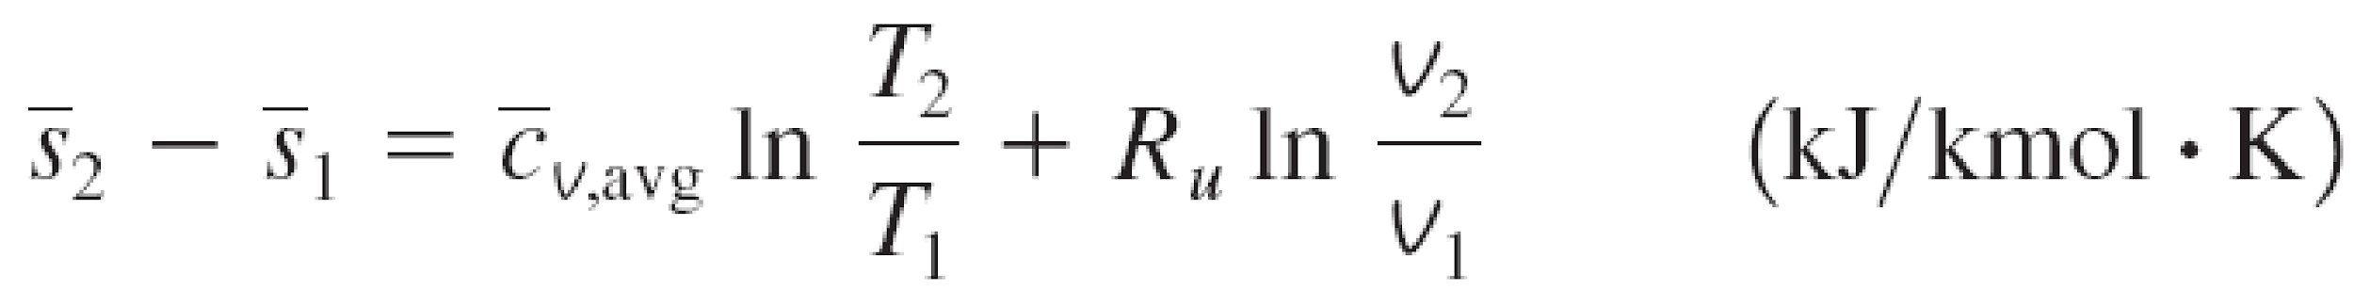
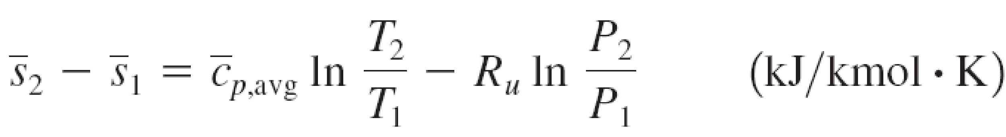
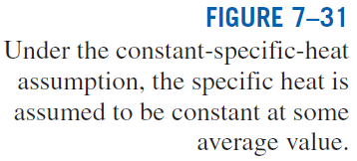
Constant Specific Heats (Approximate Analysis)
Entropy change of an ideal gas on a unit–mole basis

Slide 13
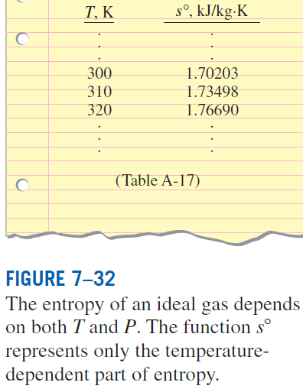
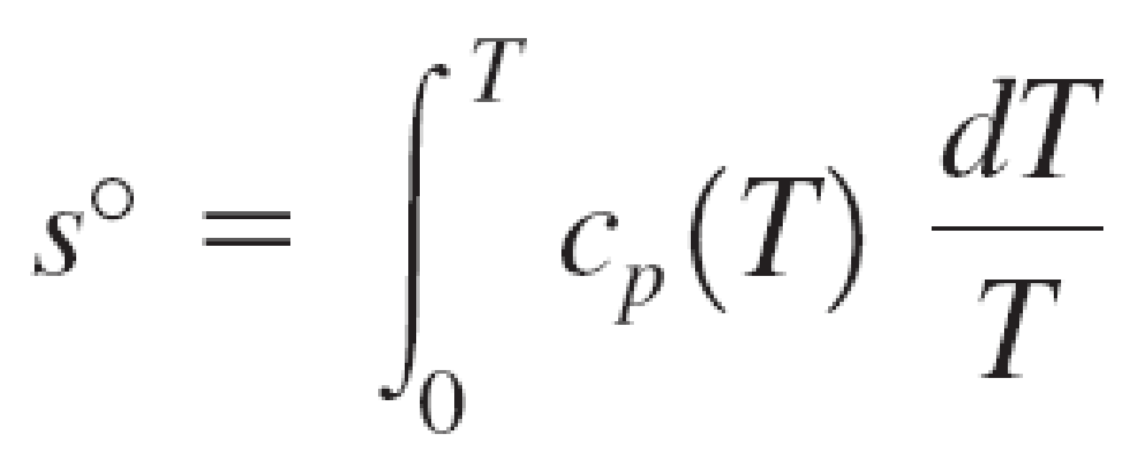
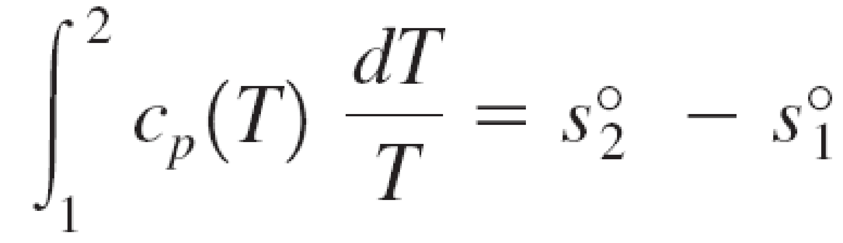
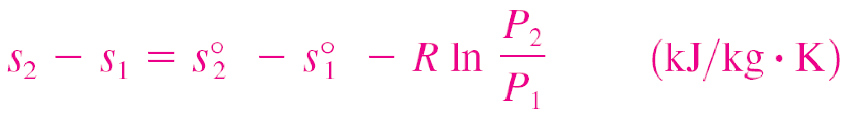

Variable Specific Heats (Exact Analysis)
We choose absolute zero as the reference temperature and define a function s° as
On a unit–mass basis
On a unit–mole basis

Slide 14
Entropy Change of an Ideal Gas
Solution
Air is compressed from an initial state of 100 kPa and 17°C to a final state of 600 kPa and 57°C. Determine the entropy change of air during this compression process (a) by using the property tables and (b) by using an average specific heat.

Slide 15




Isentropic Process of Ideal Gases
Constant Specific Heats (Approximate Analysis)
Recall for an ideal gas:

Slide 16



Isentropic Process of Ideal Gases
Constant Specific Heats (Approximate Analysis)

Slide 17




Isentropic Process of Ideal Gases
Constant Specific Heats (Approximate Analysis)
Recall for an ideal gas:

Slide 18



Isentropic Process of Ideal Gases
Constant Specific Heats (Approximate Analysis)

Slide 19



Isentropic Process of Ideal Gases
Constant Specific Heats (Approximate Analysis)

Slide 20
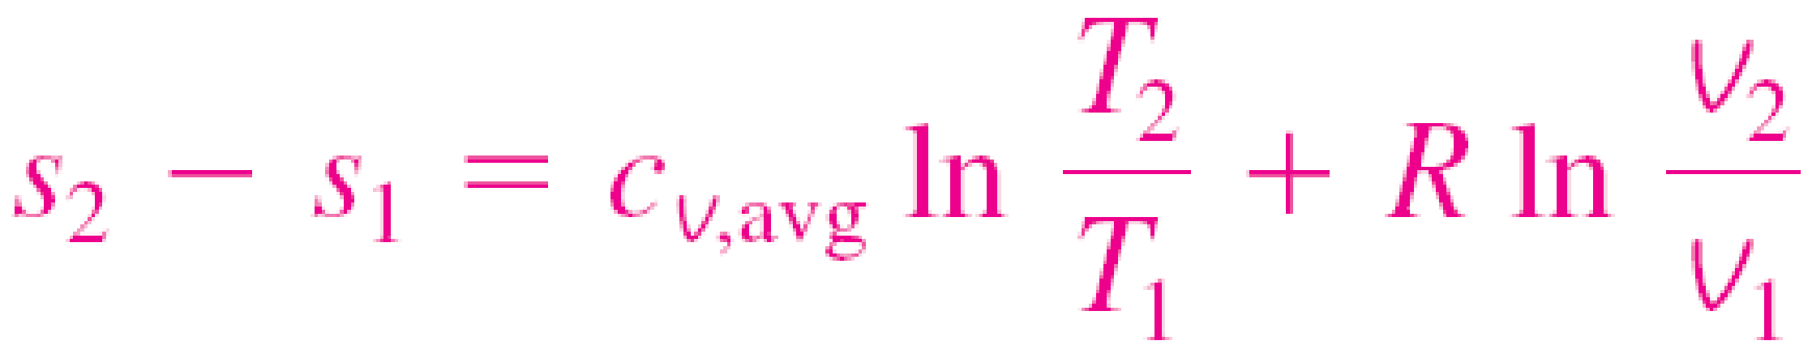
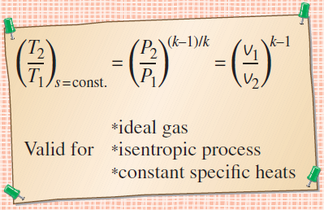
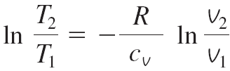
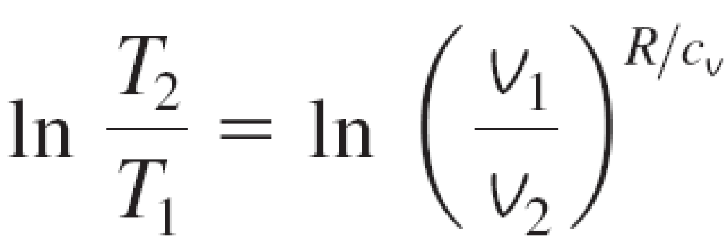
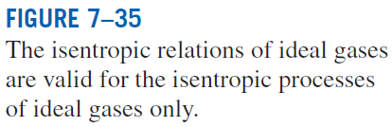
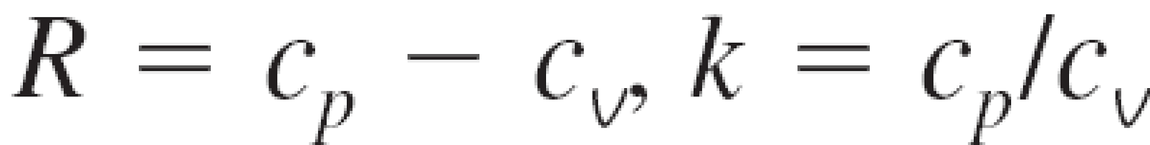
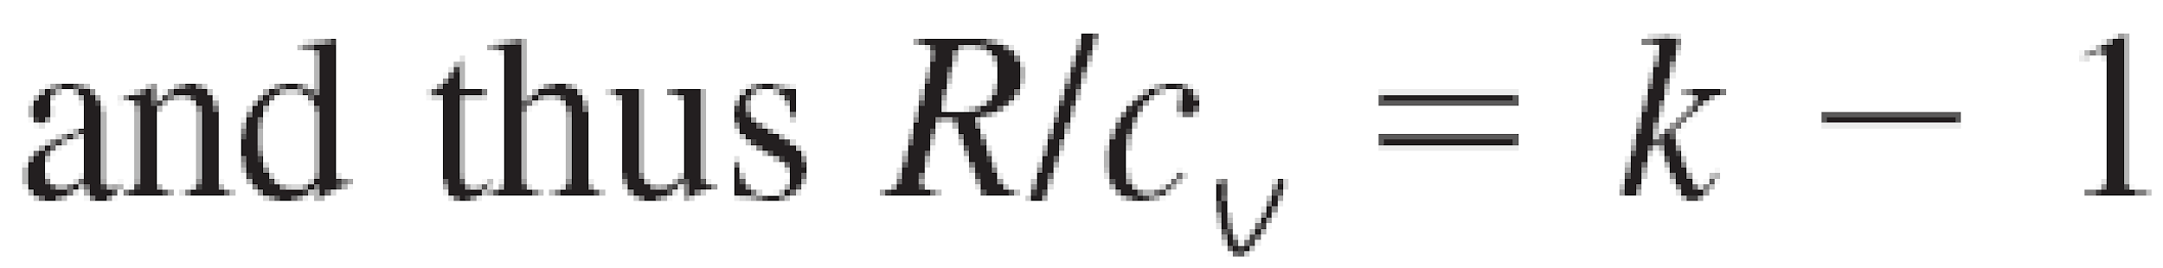
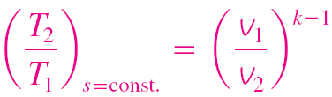
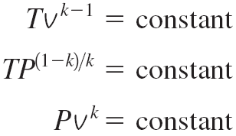
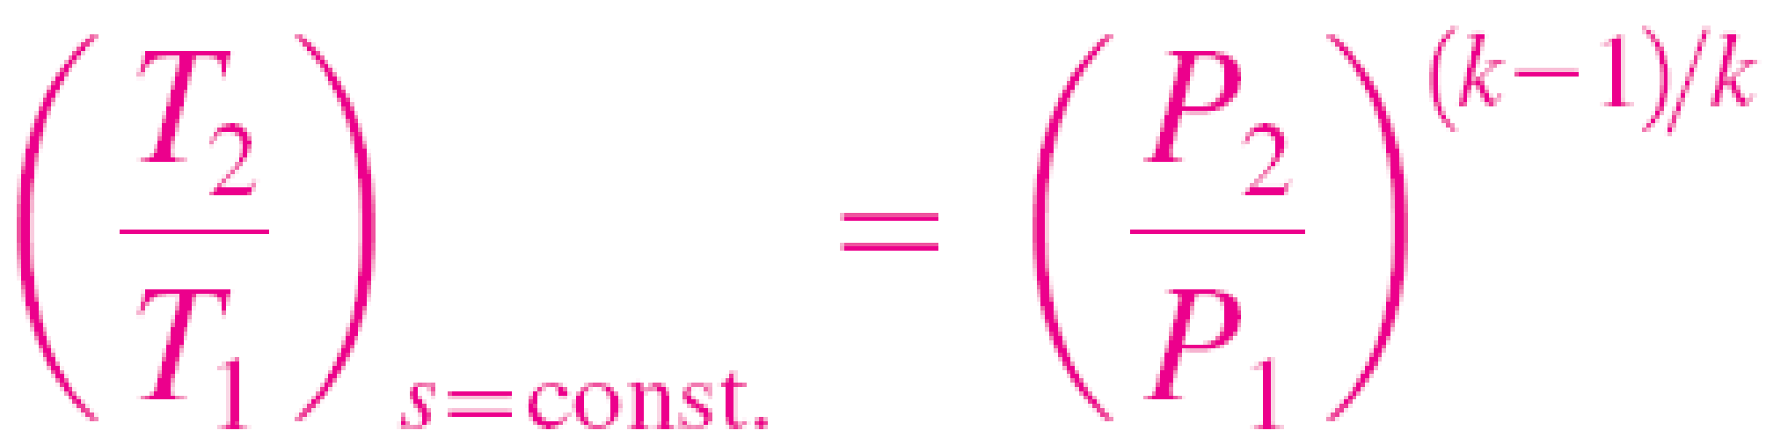
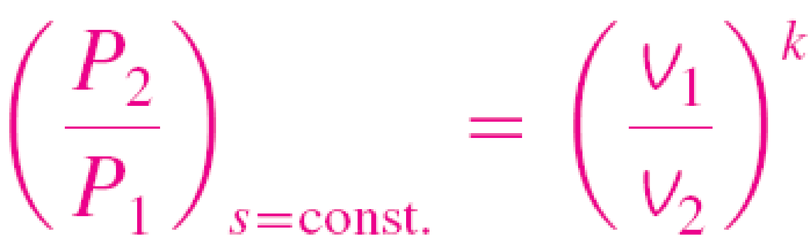
Isentropic Processes of Ideal Gases
Constant Specific Heats (Approximate Analysis)
Setting this eq. equal to zero, we get

Slide 21
Isentropic Compression of an Ideal Gas
Solution
Helium gas is compressed by an adiabatic compressor from an initial state of 14 psia and 50°F to a final temperature of 320°F in a reversible manner. Determine the pressure of the helium at the exit.

Slide 22
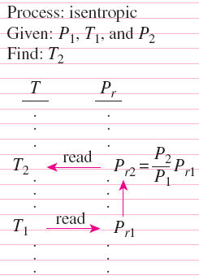


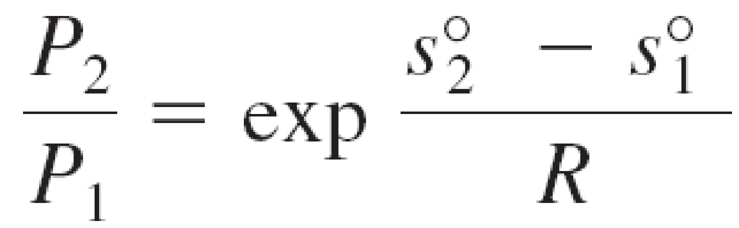
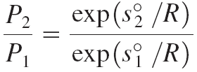
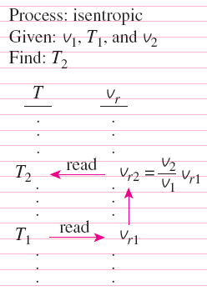
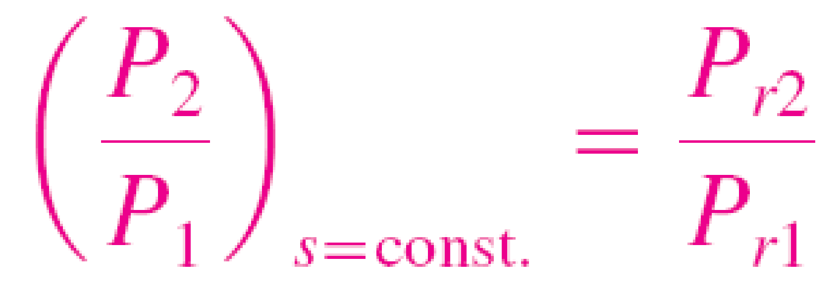
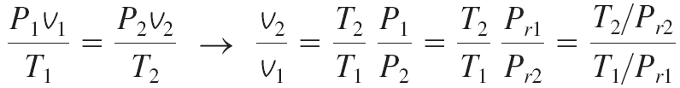
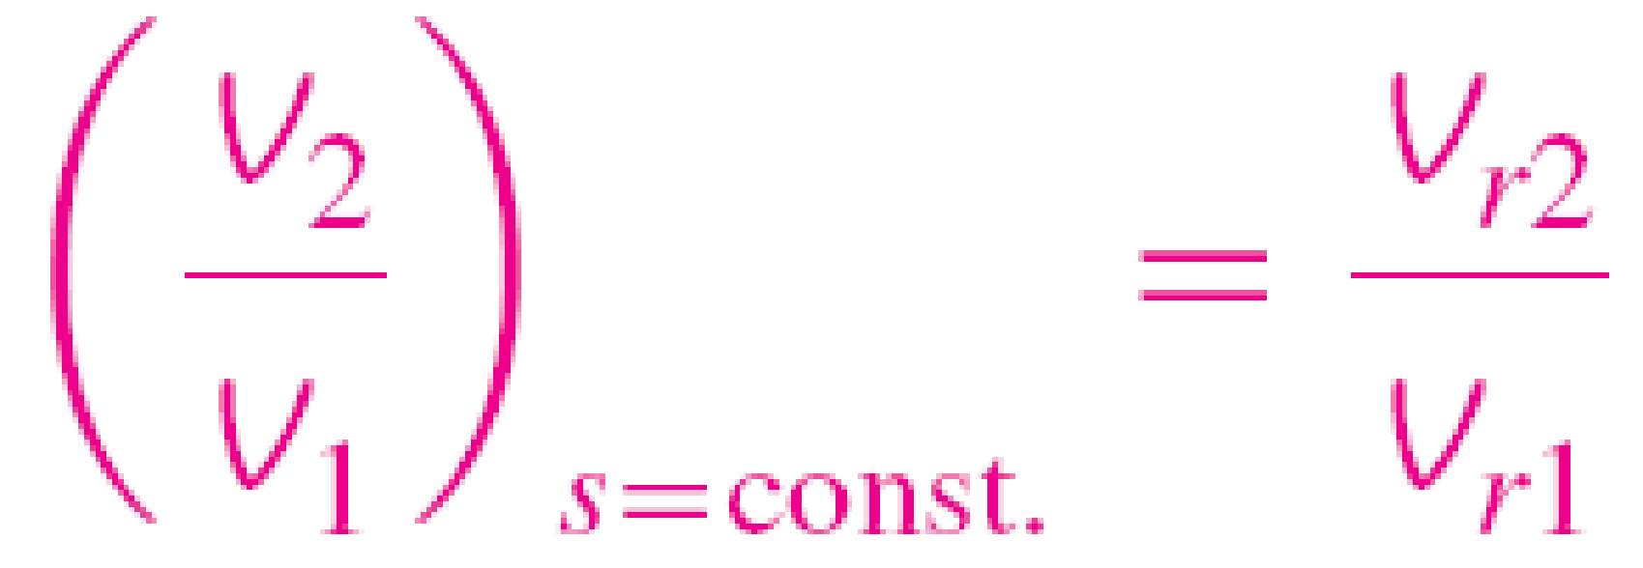
Isentropic Processes of Ideal Gases
Variable Specific Heats (Exact Analysis)
Relative Pressure and Relative Specific Volume
exp(s°/R) is the relative pressure P_{r}.
The use of P_{r} data for calculating the final temperature during an isentropic process.
The use of v_{r} data for calculating the final temperature during an isentropic process
T/P_{r} is the relative
specific volume v_{r}.

Slide 23
Practice
Solution
Air is compressed in a car engine from 22ºC and 95 kPa in a reversible and adiabatic manner. If the compression ratio (v₁/v₂) of the engine is 8, determine the final temperature of the air.

Slide 24
Summary
The T ds relations
Entropy change of liquids and solids
The entropy change of ideal gases

